Slide 1
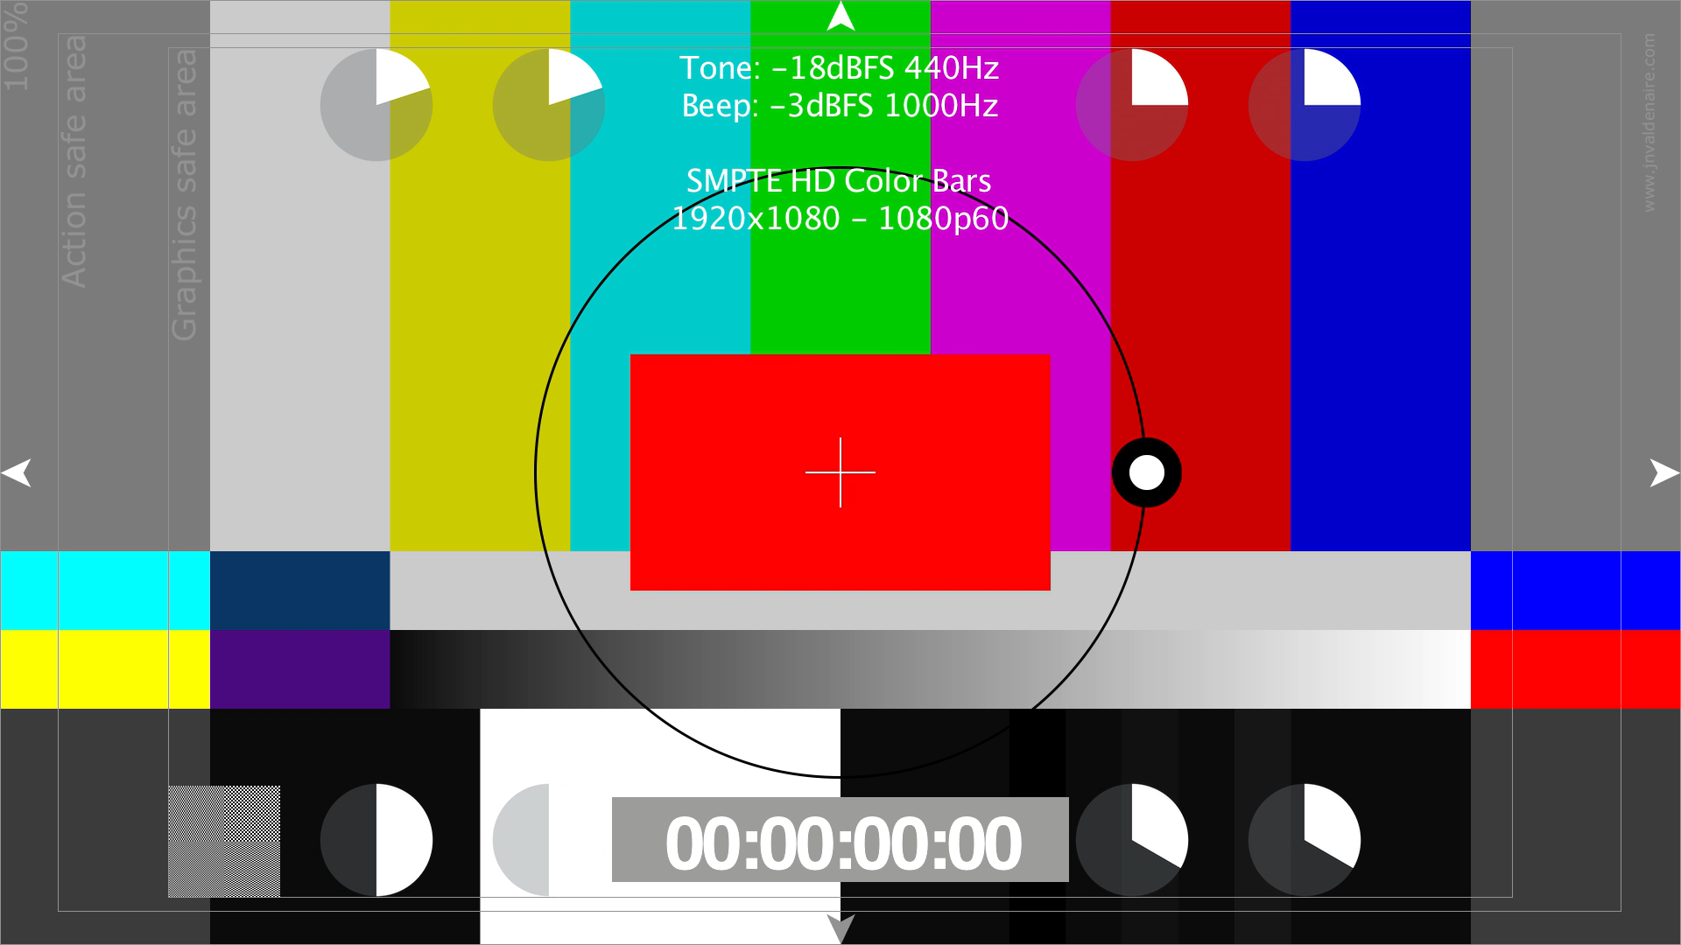
Notes:
Video Test

Slide 3
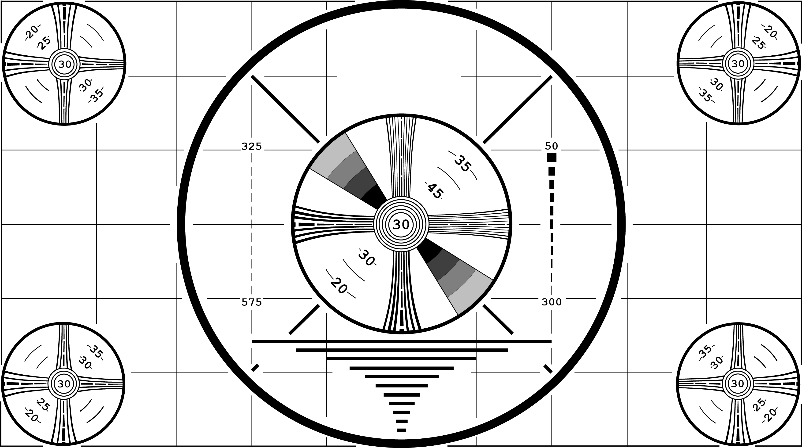



Slide 4


Slide 5

Notes:
Phillips Test Pattern

Slide 6
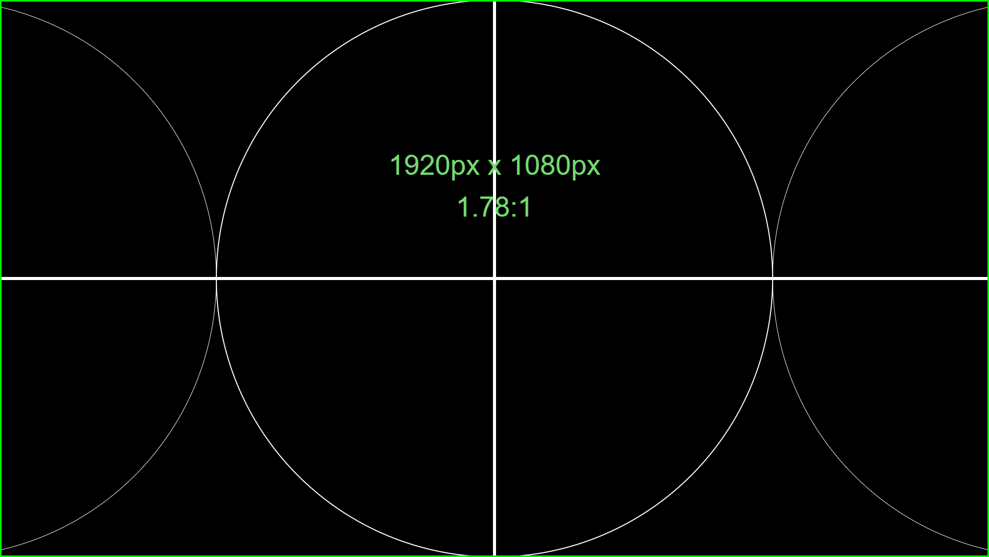

Slide 7
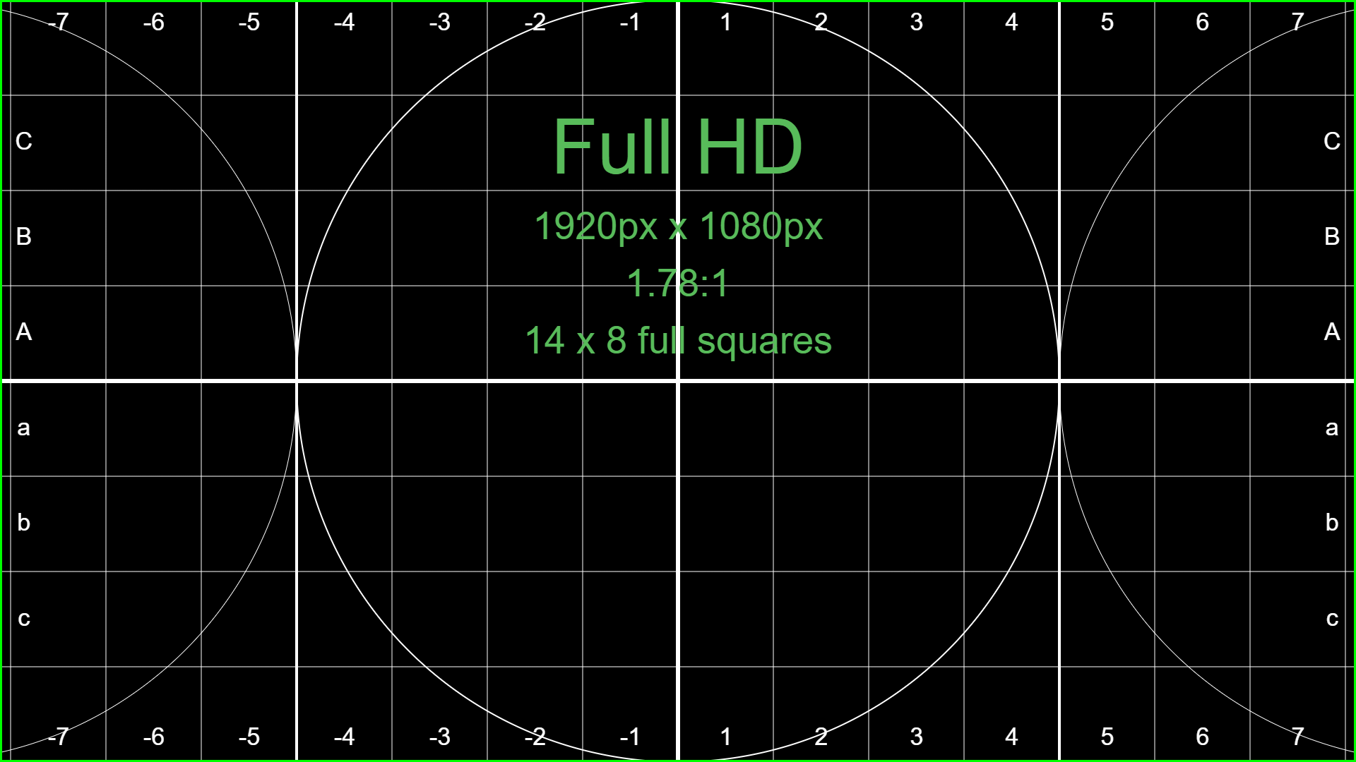
Notes:
Full HD 1920x1080 Test Pattern

Slide 8
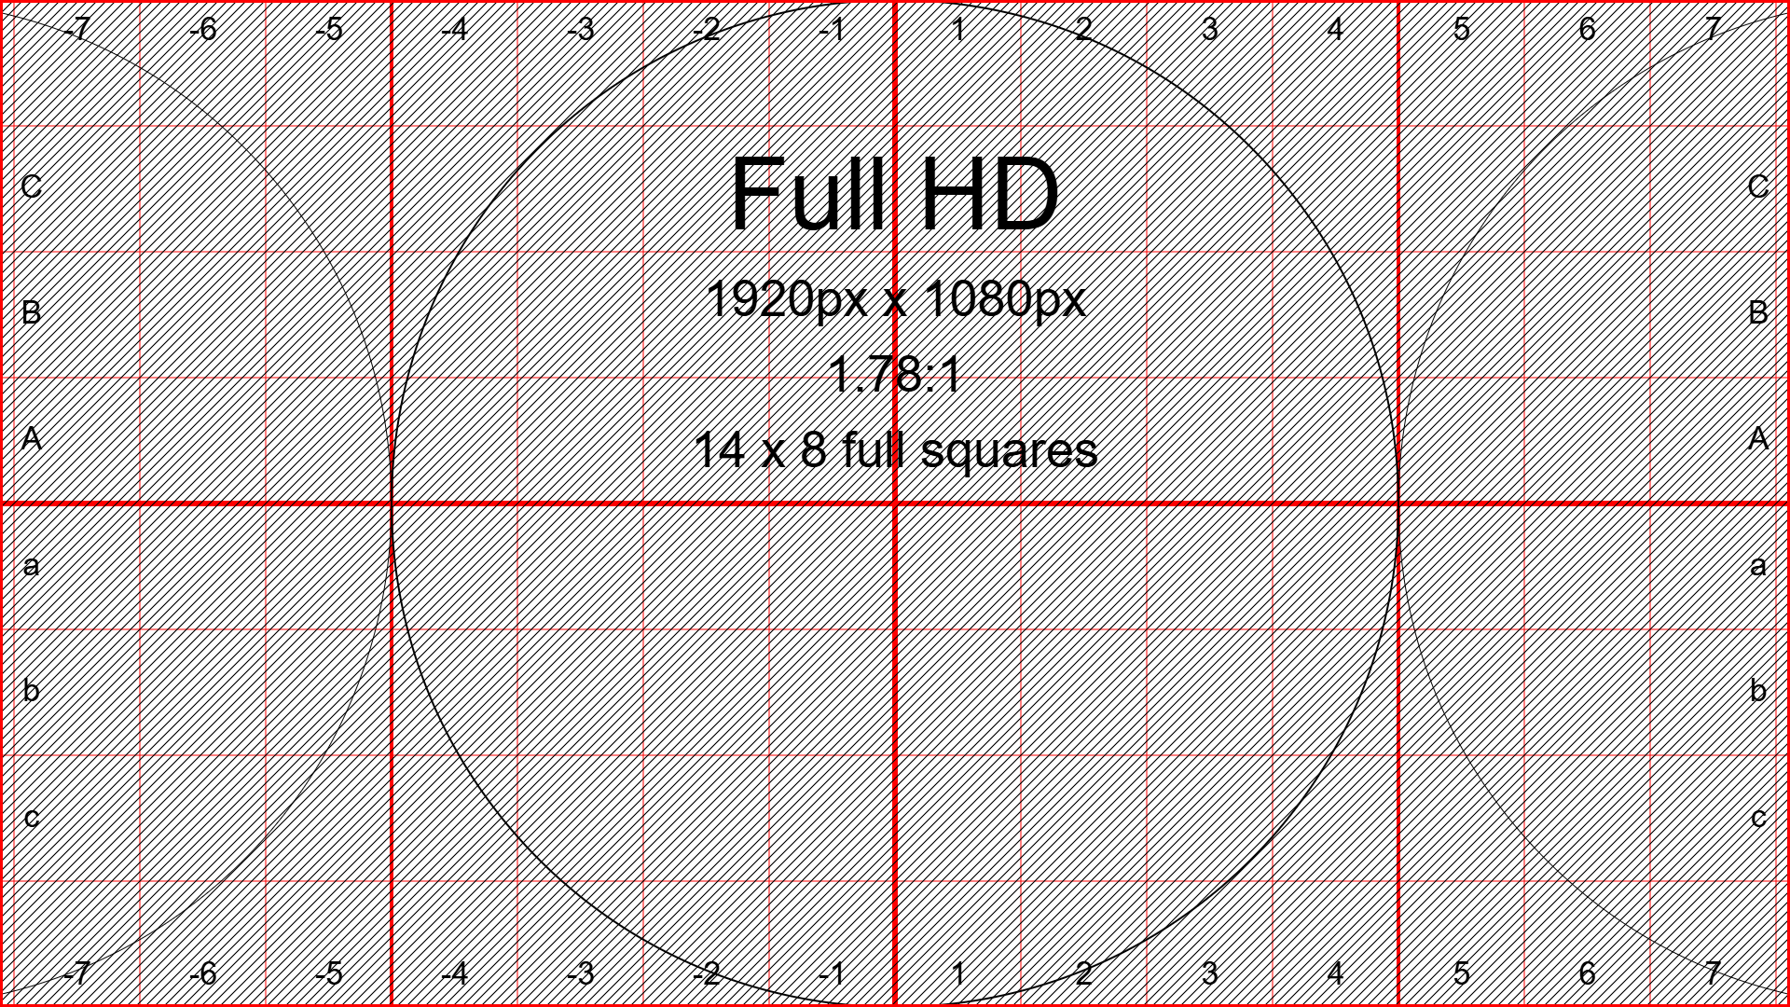
Notes:
Inverted Full HD 1920x1080 Test Pattern with Cross Hatch

Slide 9
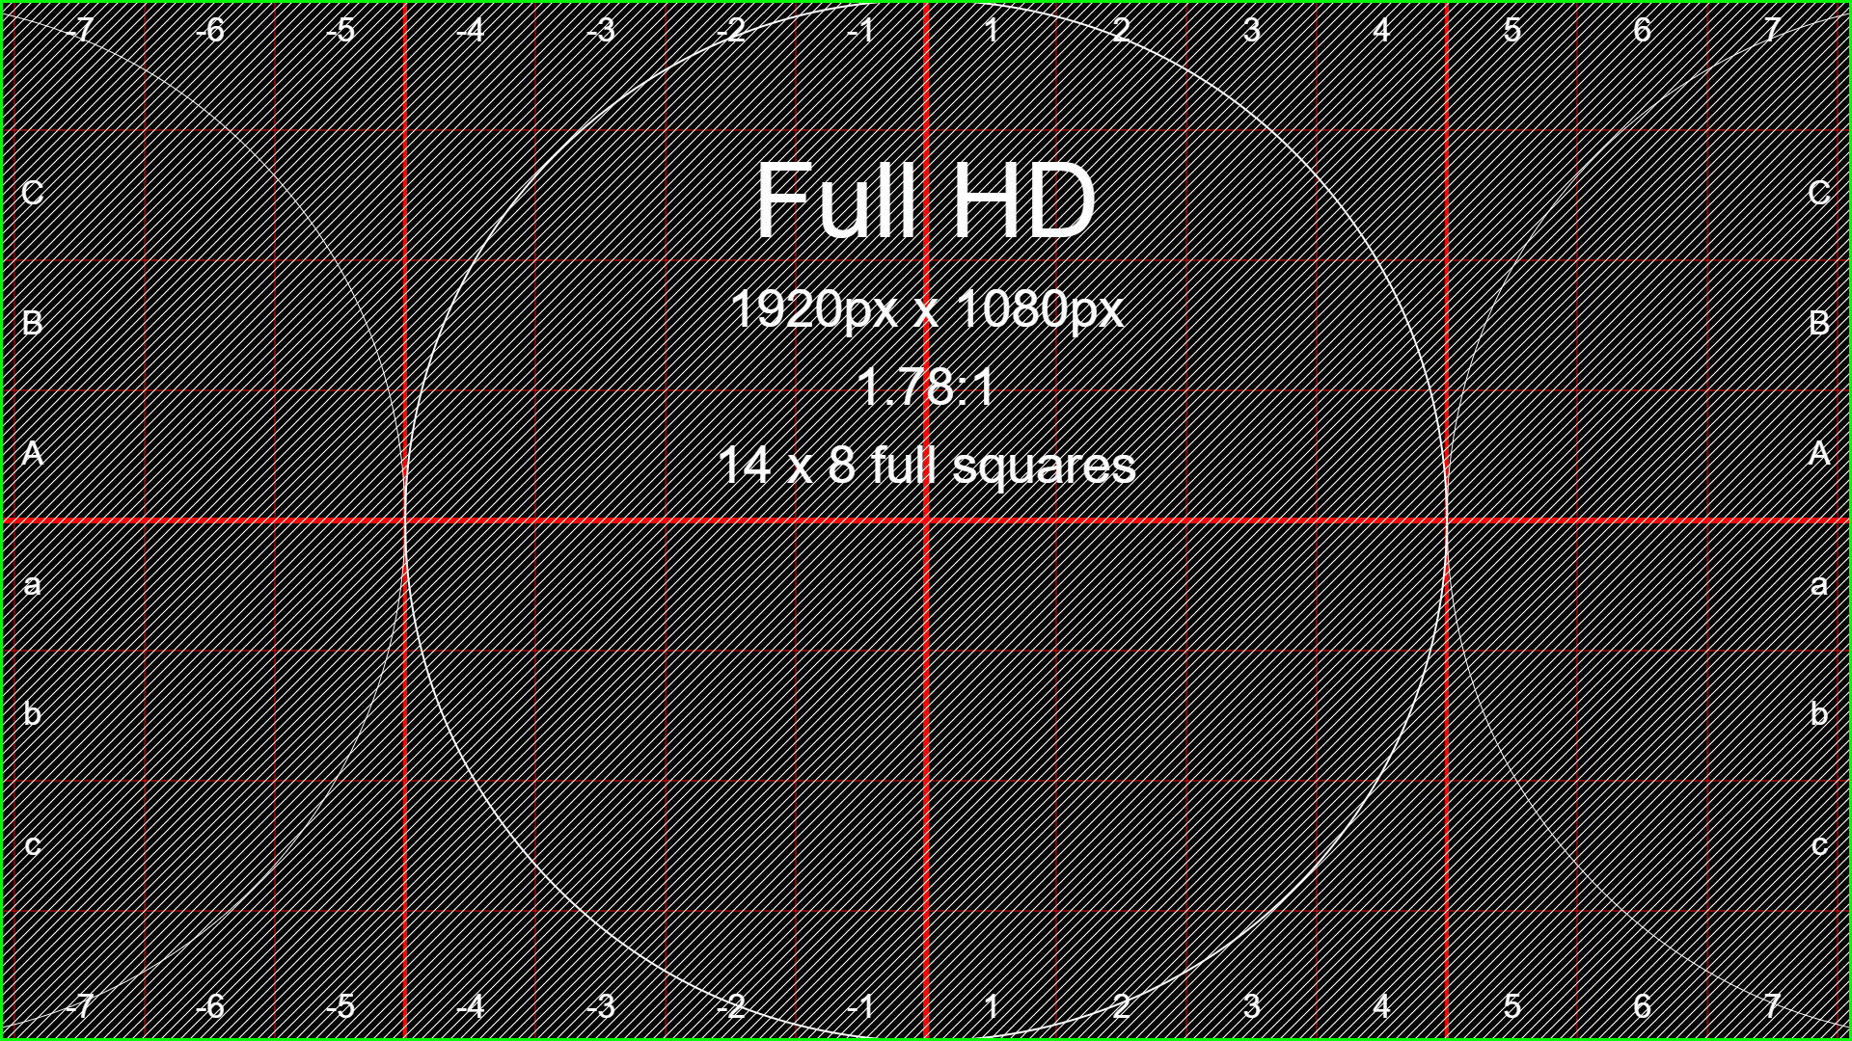
Notes:
Full HD 1920x1080 Test Pattern with Cross Hatch

Slide 10
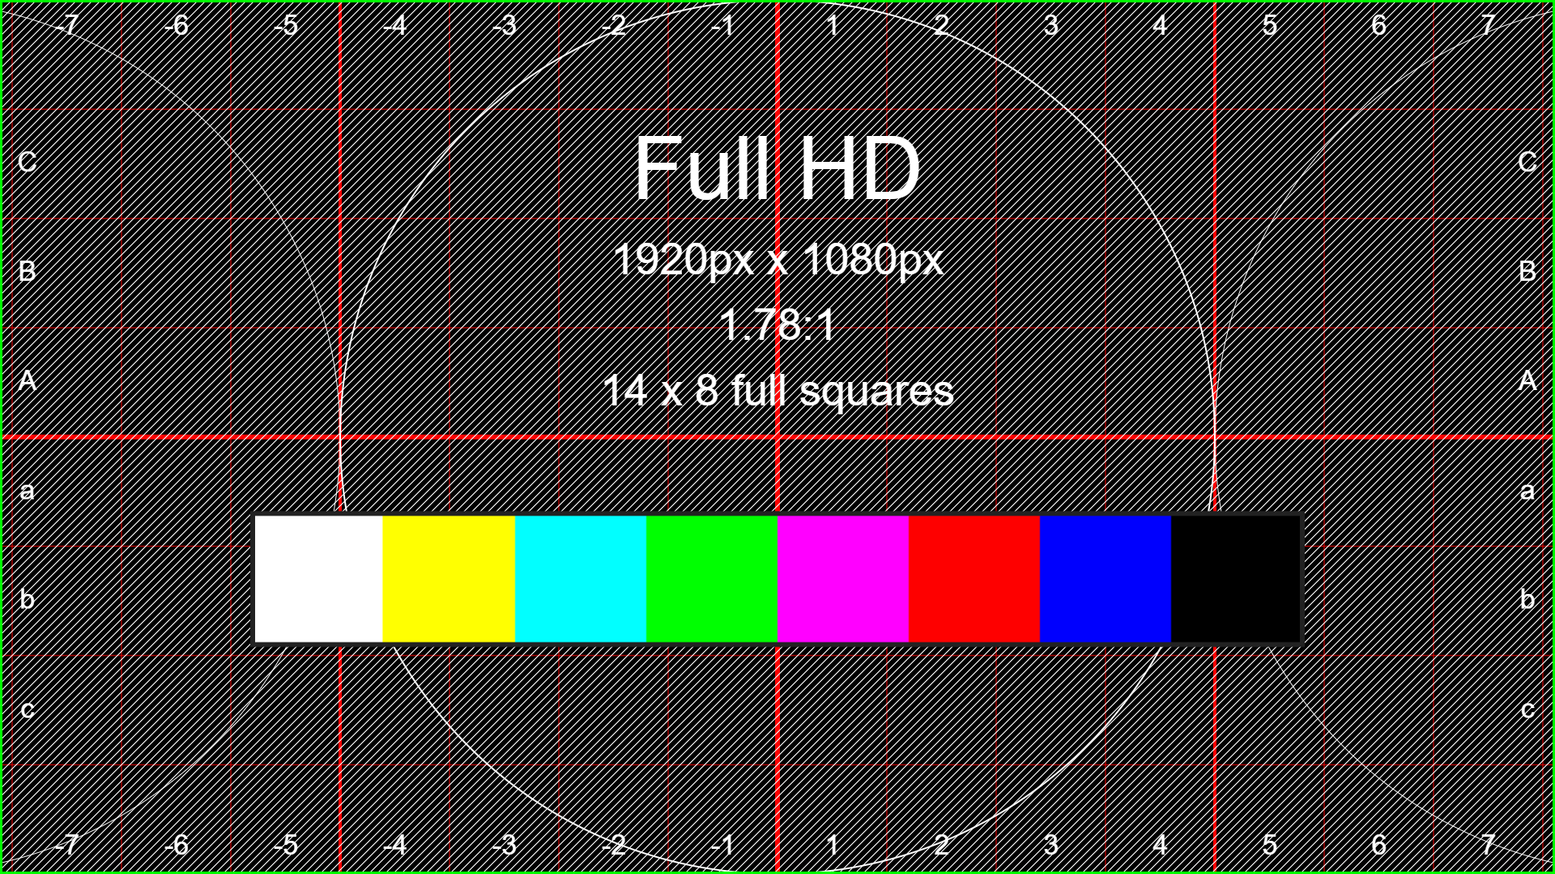
Notes:
Full HD 1920x1080 Test Pattern with Cross Hatch & Color Bar

Slide 11
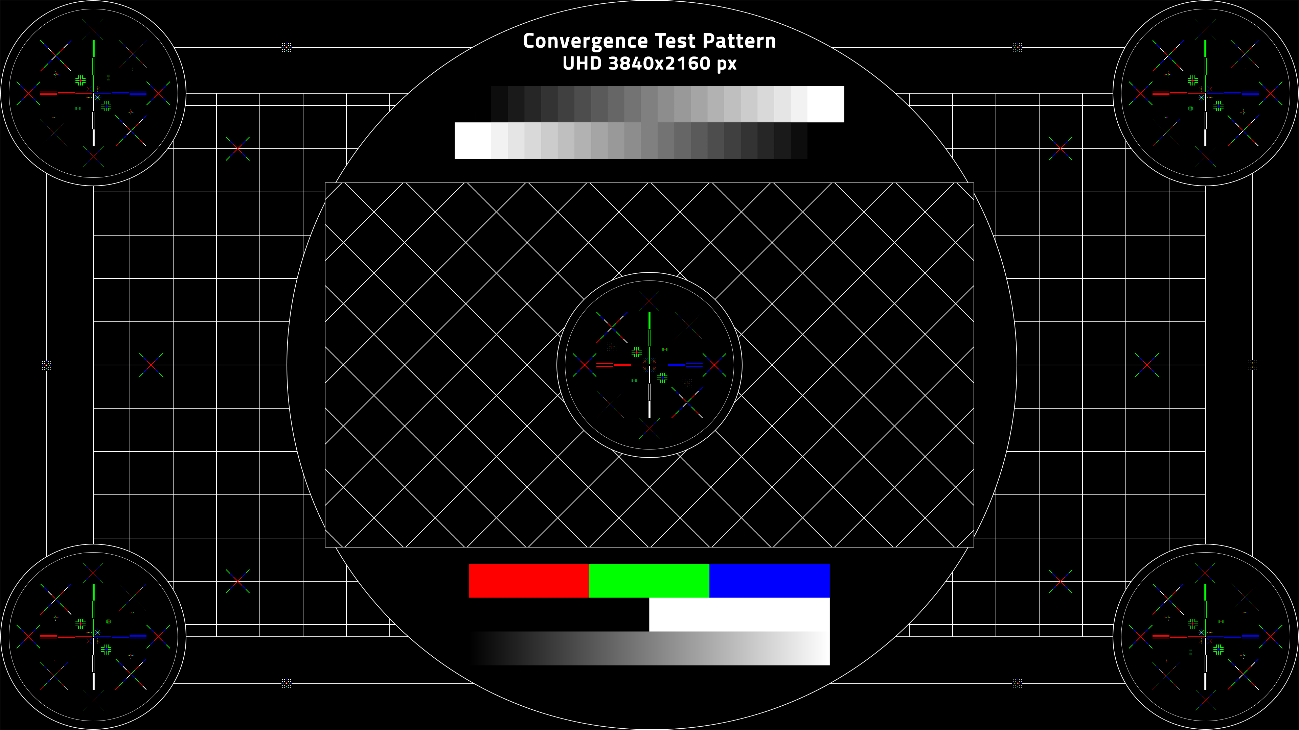

Notes:
Convergence Test Pattern

Slide 12
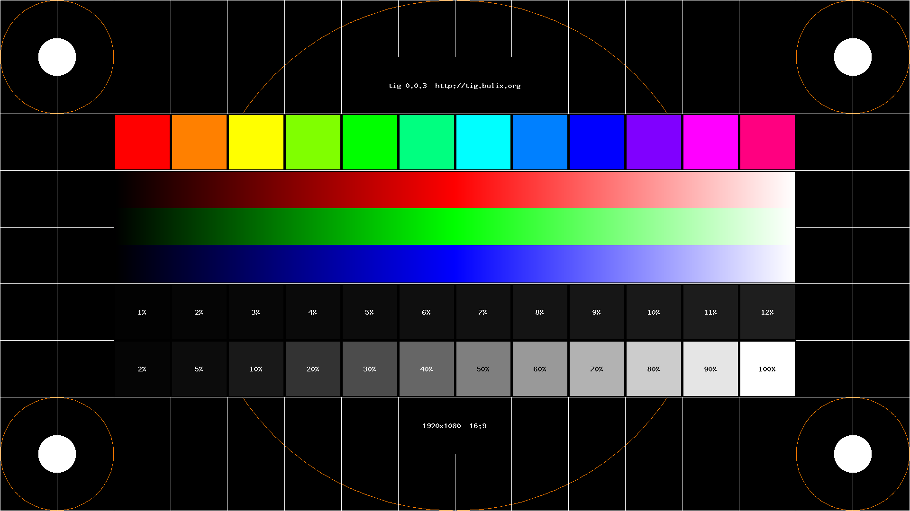
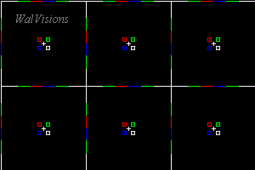


A B C D E F G H I J K L M N O P Q R S T U V W X Y Z
a b c d e f g h I j k l m n o p q r s t u v w x y z
0 1 2 3 4 5 6 7 8 9
0123456789
#=#=#
Notes:
1920x1080 Custom Test Pattern

Slide 13
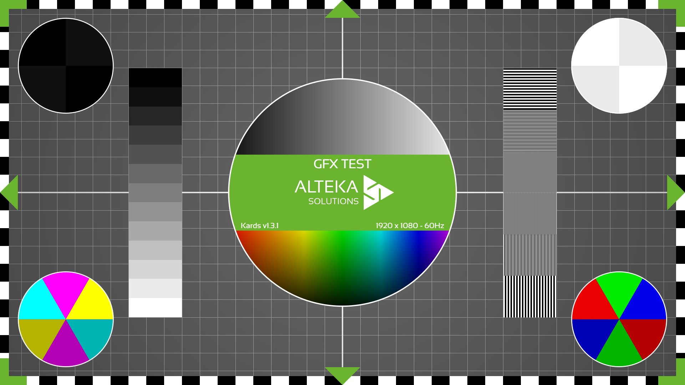
Notes:
Alteka.Solutions Test Pattern

Slide 14
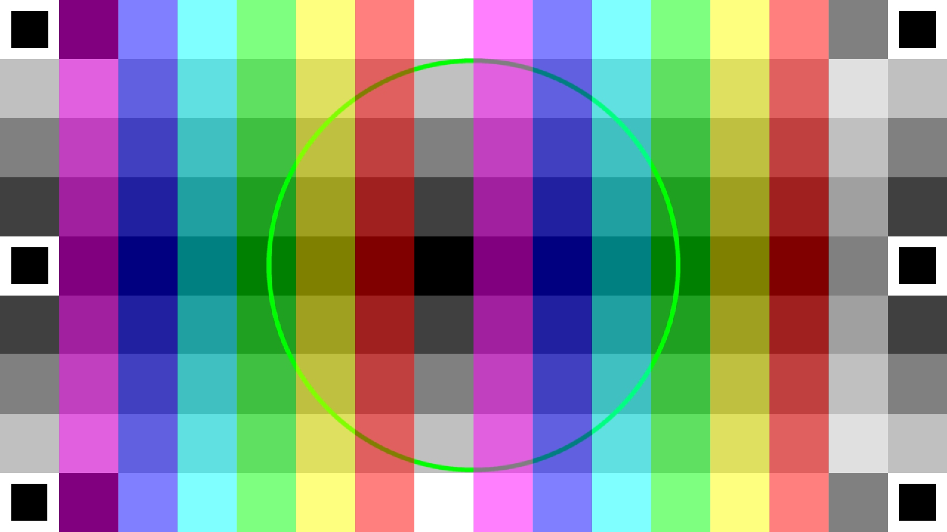

Slide 15
Notes:
16X9 Color Bars 100%

Slide 16

Notes:
Color Pinwheel

Slide 17


Slide 18

Notes:
Blank White

Slide 19
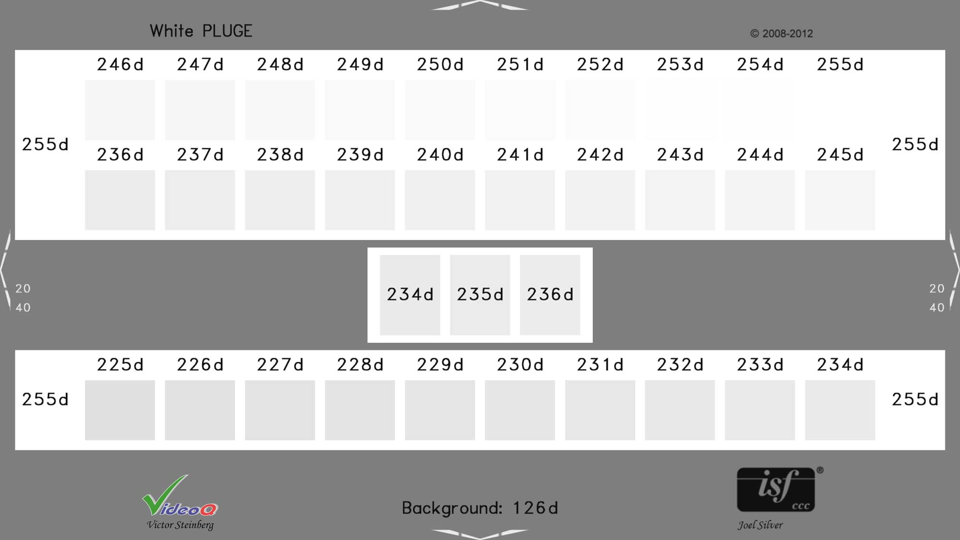
Notes:
Whites

Slide 20
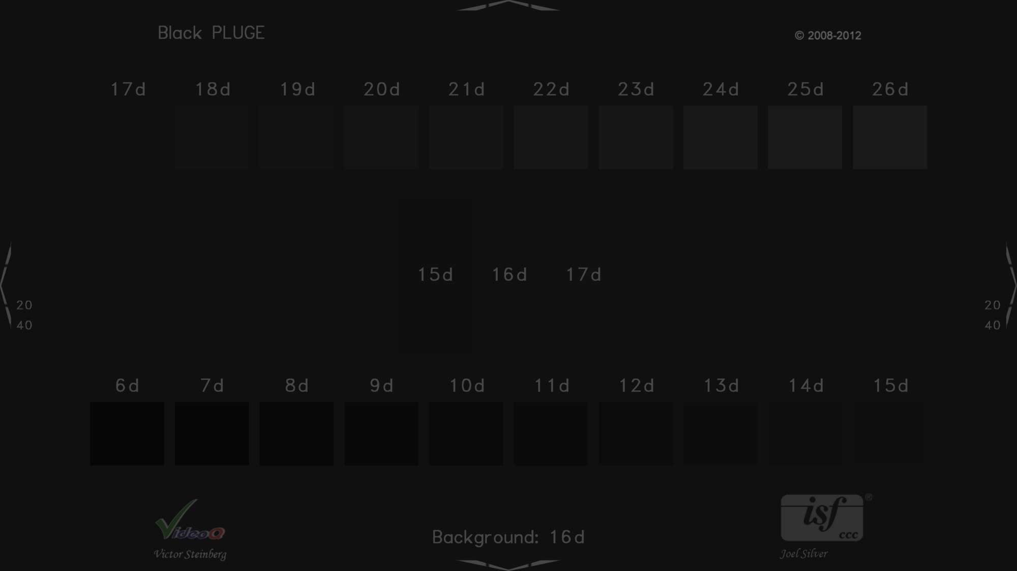
Notes:
Blacks

Slide 21

Notes:
Black & White Gradient Steps

Slide 22
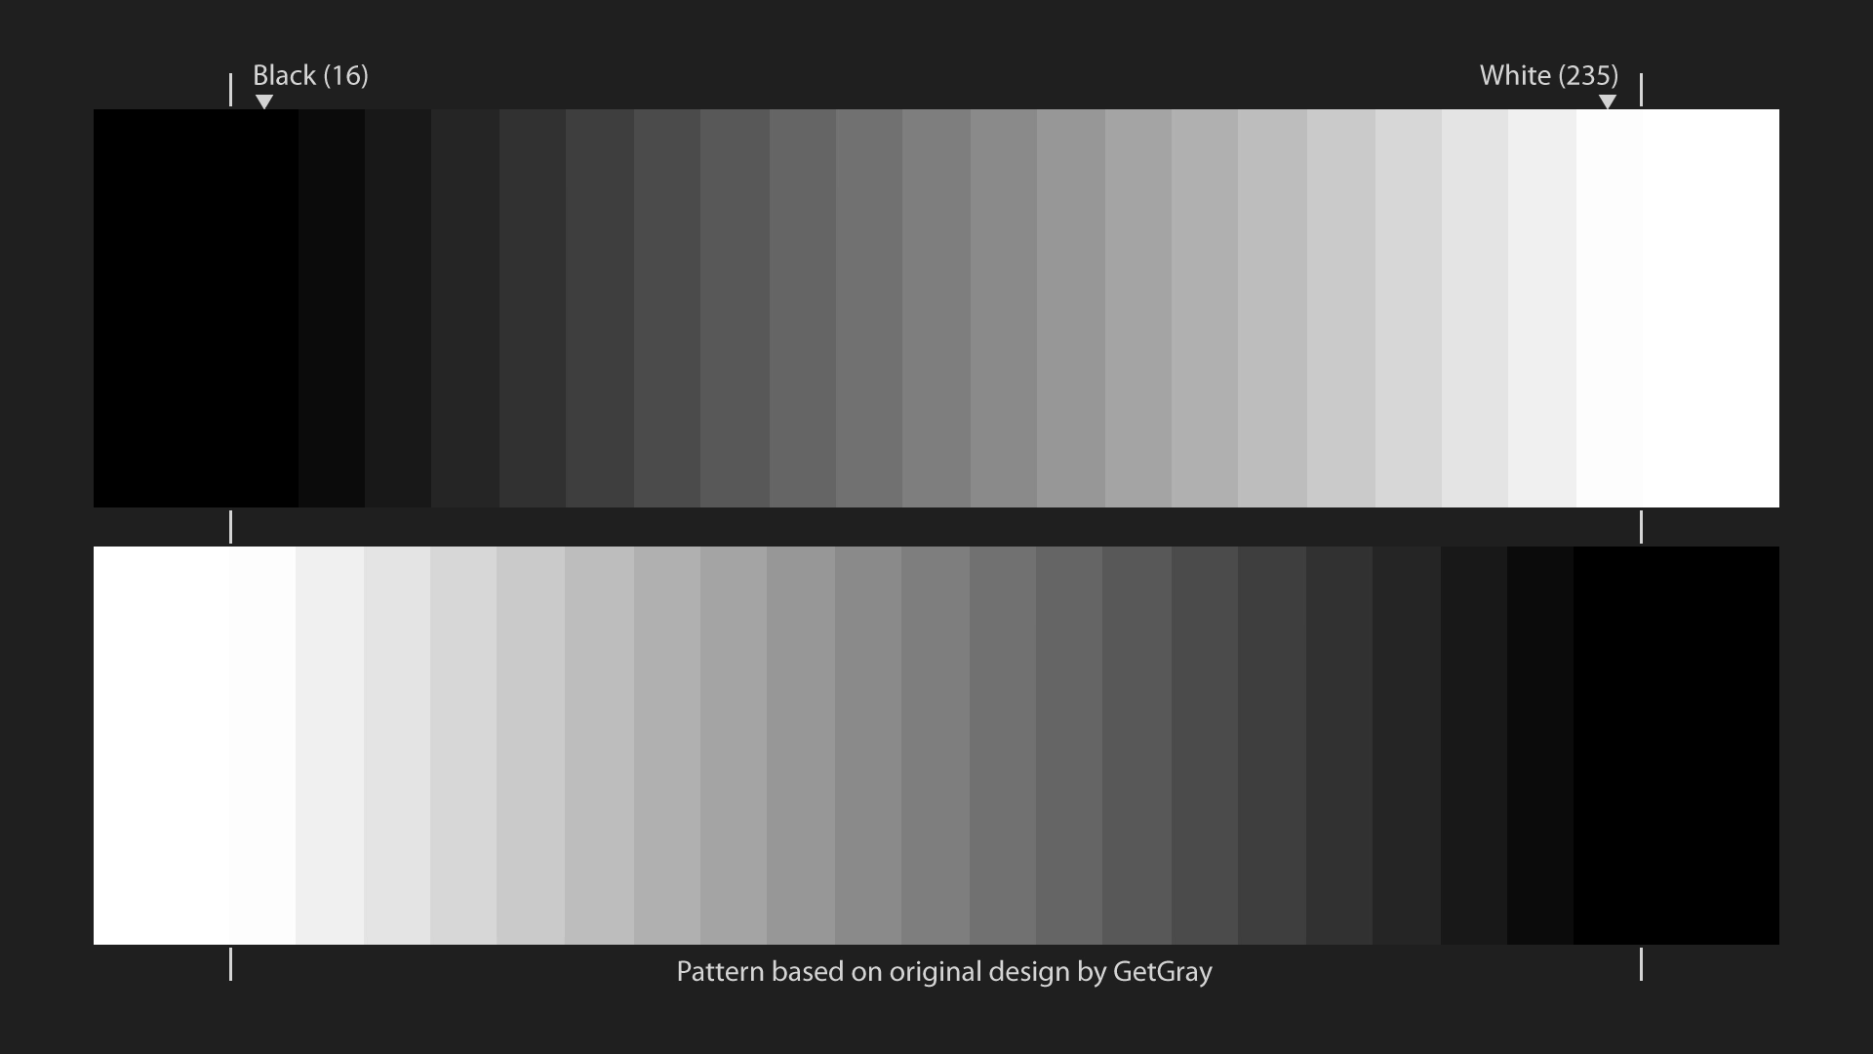

Slide 23
Notes:
Green Screen

Slide 24
Notes:
Blue Screen

Slide 25
Notes:
Cyan Screen

Slide 26
Notes:
Magenta Screen

Slide 27
Notes:
Red Screen

Slide 28
Notes:
Yellow Screen

Slide 29
Notes:
White Screen

Slide 30
Notes:
Black/Green Screen

Slide 31
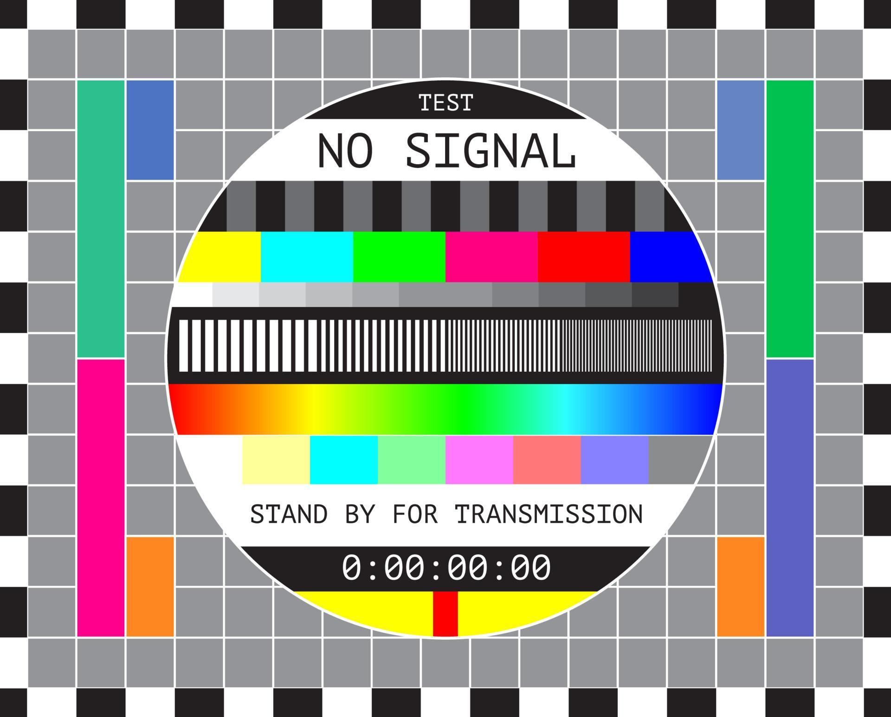
Notes:
4:3 No Signal

Slide 32


Slide 33


OVER SCHEDULED TIME
PLEASE
WRAP IT UP

Slide 34
CUSTOM MESSAGE

Slide 35
CUSTOM MESSAGE
NEXT CUE #

Slide 36


Slide 37

zoom.us/test
devicetest.teams.microsoft.com
Notes:
Zoom & Microsoft Teams Test Links

Slide 38

Miscellaneous Test Pattern Links:
WalVisions - Convergence Test
WalVisions - Alternating Pixel ON_OFF Pattern
WalVisions - Equal Level Pattern

Slide 39
GFX 1 program
Notes:
Graphics 1

Slide 40
GFX 2
Notes
Notes:
Graphics 2

Slide 41


Notes:
Company Logo with Earth background

